Slide 1

Section 4.4 Indeterminant Forms and l'Hospital's Rule
Lecture 1
Central challenge of calculus

Slide 2

Homework Submission to Canvas
Preview of section
Skim the section in text and write a short paragraph summary.
Give a bulleted list of all important definitions, theorems, and formulas without details.
Notes on video lectures
Take notes on everything written on slides including all details, worked examples, on-own activities, as well as your own thoughts and questions.
Try on-own activities first, then write down provided solution next to it for comparison.
Worked examples from the text
Write down the problem and attempt without looking at the solution.
Use the solution to write the best explanation you can.
Solutions to textbook exercises
Model approaches and explanations given in the video lectures and textbook examples.
Final reflection of section
List the key takeaways to remember as a bulleted list.
Video reflection (for some sections)
Write a 1 paragraph reflection on the video discussing what you found most interesting or useful.

Slide 3
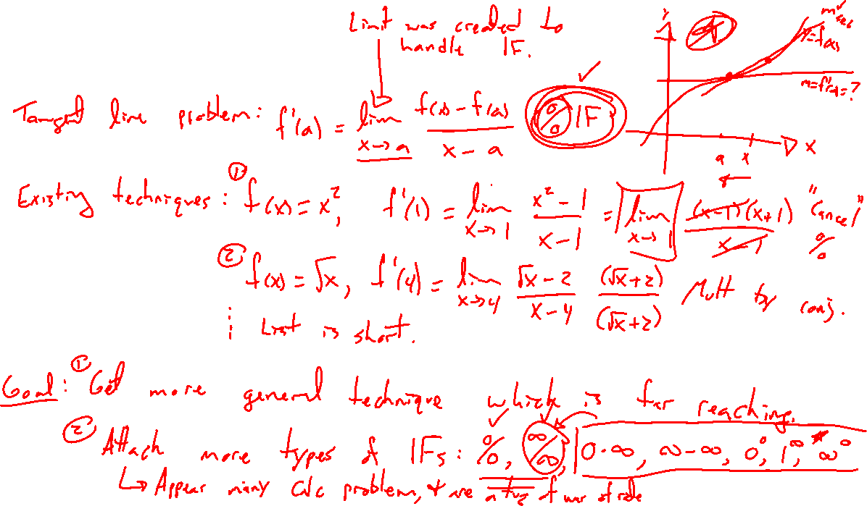
Recall: Indeterminant form
Notes:
Limit of difference quotient. 0/0 IF. Limit idea invented to handle this problem.
Already have techniques: f(x)=x^2, f'(1)=? F(x)=\sqrt{x}, f'(1)=?
Our techniques are not enuf: f(x)=\ln(x), f'(1)=?
Lot's of indeterminant forms: 0/0, inf/inf, 0*inf, inf-inf, 0^0, 1^inf, inf^0
All are a tug of war of rates

Slide 4
Recall: Indeterminant form
Notes:
Limit of difference quotient. 0/0 IF. Limit idea invented to handle this problem.
Already have techniques: f(x)=x^2, f'(1)=? F(x)=\sqrt{x}, f'(1)=?
Our techniques are not enuf: f(x)=\ln(x), f'(1)=?
Lot's of indeterminant forms: 0/0, inf/inf, 0*inf, inf-inf, 0^0, 1^inf, inf^0
All are a tug of war of rates

Slide 5
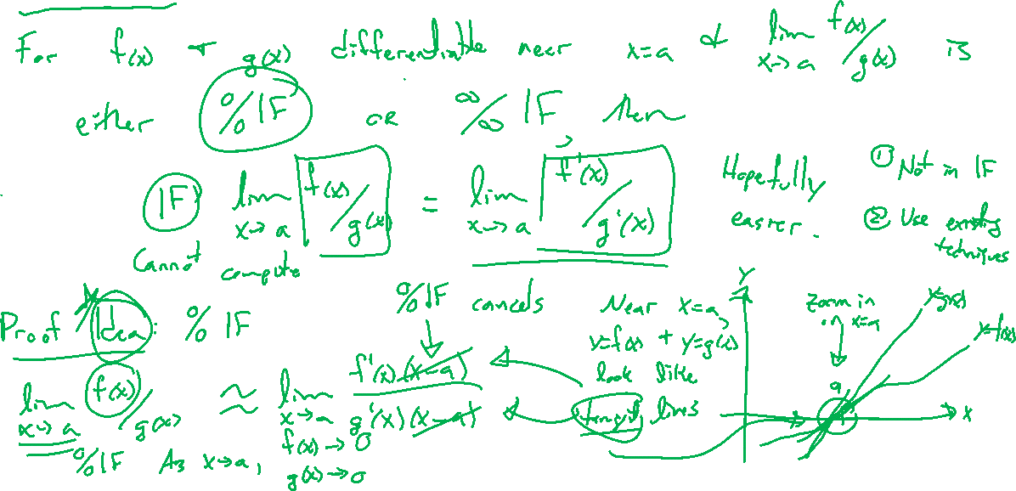
Theorem: l'Hospital's Rule
Notes:
For f and g differentiable around x=a and lim_{x\rightarrow a} f(x)/g(x) either 0/0 or inf/inf IF, then
lim_{x\rightarrow a} f(x)/g(x) = lim_{x\rightarrow a} f'(x)/g'(x)
Proof idea: 0/0 IF case, Close to x=a, replace f(x) with f'(a)(x-a) (tangent line approximation). (draw graph)
Tangent line tells rate to 0 or inf
Note, theorem holds for +- inf limits as well as right and left limits

Slide 6
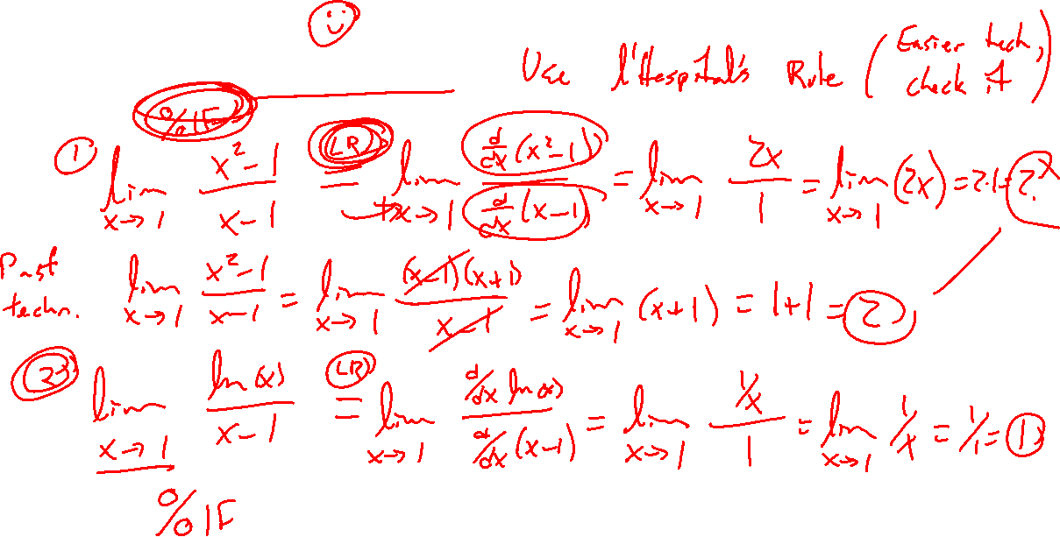
Examples: Try on own
Notes:
Note, check the IF first before can apply
\lim_{x \rightarrow 1} (x^2-1)/(x-1)
\lim_{x \rightarrow 1} ln(x)/(x-1)

Slide 7
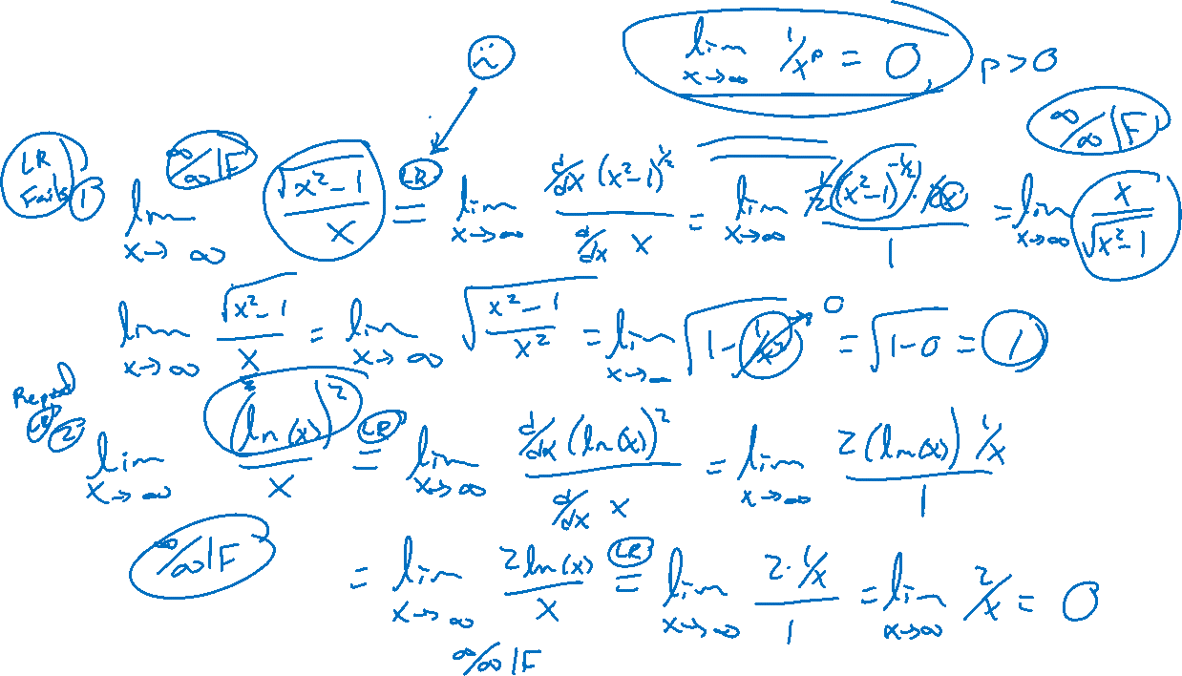
Examples: Try on own, but beware
Notes:
Note, check the IF first before can apply
\lim_{x \rightarrow inf} \sqrt{x^2-1}{x}
\lim_{x \rightarrow inf} (ln(x))^2/x

